Slide 1
Equipping Night
February 28, 2024

Slide 2
Mission of Equipping Nights
Forming a Biblical Worldview from All of Scripture, for All of Life

Slide 3
Unity in the Truth: Knowing What Hills to Die on in Church and Theology

Slide 4
John 17:9-11
⁹I am praying for them. I am not praying for the world but for those whom you have given me, for they are yours.
¹⁰All mine are yours, and yours are mine, and I am glorified in them.
¹¹And I am no longer in the world, but they are in the world, and I am coming to you. Holy Father, keep them in your name, which you have given me, that they may be one, even as we are one.

Slide 5
John 17:20-21
²⁰“I do not ask for these only, but also for those who will believe in me through their word,
²¹that they may all be one, just as you, Father, are in me, and I in you, that they also may be in us, so that the world may believe that you have sent me.

Slide 6
John 17:17-19
¹⁷Sanctify them in the truth; your word is truth.
¹⁸As you sent me into the world, so I have sent them into the world.
¹⁹And for their sake I consecrate myself, that they also may be sanctified in truth.

Slide 7
Key Term “Theological Triage”

Slide 9
Recommended Resources
Albert Mohler: “A Call for Theological Triage and Christian Maturity”
Gavin Ortlund: Finding the Right Hills to Die On: The Case for Theological Triage
Video from TGC on YouTube: “How Pastors Can Effectively Practice Theological Triage”

Slide 10
Avoiding Two Opposite Errors
Doctrinal Sectarianism (being overly divisive)

Slide 11
Avoiding Two Opposite Errors
Doctrinal Sectarianism (being overly divisive)
2. Doctrinal Minimalism (downplaying doctrine)

Slide 12
Theological Triage in Scripture
Galatians 1:8-9
⁸But even if we or an angel from heaven should preach to you a gospel contrary to the one we preached to you, let him be accursed. ⁹As we have said before, so now I say again: If anyone is preaching to you a gospel contrary to the one you received, let him be accursed.

Slide 13
Theological Triage in Scripture
1 Corinthians 15:3-4
³For I delivered to you as of first importance what I also received: that Christ died for our sins in accordance with the Scriptures, ⁴that he was buried, that he was raised on the third day in accordance with the Scriptures,

Slide 14
Theological Triage in Scripture
1 Corinthians 15:14, 17
¹⁴And if Christ has not been raised, then our preaching is in vain and your faith is in vain.
¹⁷And if Christ has not been raised, your faith is futile and you are still in your sins.

Slide 15
Theological Triage in Scripture
Romans 14:1-6
¹As for the one who is weak in faith, welcome him, but not to quarrel over opinions.
²One person believes he may eat anything, while the weak person eats only vegetables.
³Let not the one who eats despise the one who abstains, and let not the one who abstains pass judgment on the one who eats, for God has welcomed him.
⁴Who are you to pass judgment on the servant of another? It is before his own master that he stands or falls. And he will be upheld, for the Lord is able to make him stand

Slide 16
Theological Triage in Scripture
Romans 14:1-6
⁵One person esteems one day as better than another, while another esteems all days alike. Each one should be fully convinced in his own mind.
⁶The one who observes the day, observes it in honor of the Lord. The one who eats, eats in honor of the Lord, since he gives thanks to God, while the one who abstains, abstains in honor of the Lord and gives thanks to God.

Slide 17
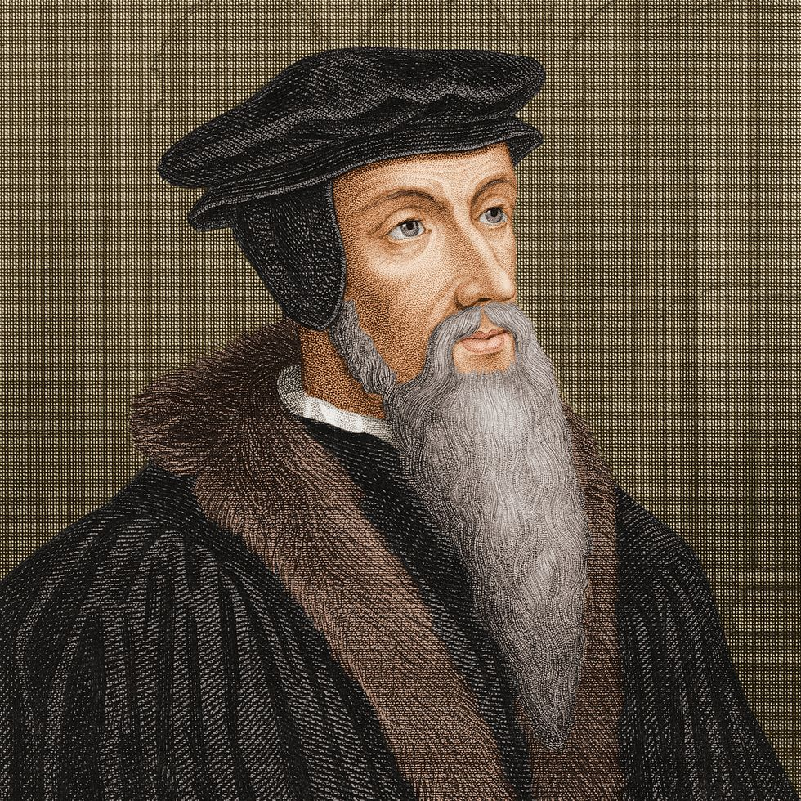
John Calvin on Theological Triage
For not all the articles of true doctrine are of the same sort. Some are so necessary to know that they should be certain and unquestioned by all men as the proper principles of religion. Such are: God is one; Christ is God and the Son of God; our salvation rests in God’s mercy; and the like. Among the churches there are other articles of doctrine disputed which still do not break the unity of faith.

Slide 18
1st Order Doctrines Essential to Christianity

Slide 19
1st Order Doctrines
Monotheism
God’s creation of the universe ex nihilo. (Out of nothing)
The Trinity
The virgin birth
The two distinct natures of Jesus – truly God and truly man.
The bodily death and burial of Jesus
The bodily resurrection and ascension of Jesus
The bodily second coming of Jesus.
The bodily resurrection of all the dead to the judgement seat of Christ.
The inspiration, truthfulness, and authority of the Bible
Justification by faith alone

Slide 20
2nd Order Doctrines Required to be a pastor or elder in a specific church

Slide 21
2nd Order Doctrines
Proper recipients of Baptism
The Doctrines of Grace (Calvinism) vs. Arminianism
Spiritual Gifts: Continuationaism vs. Cessationism
Structure of Church Government
Complementarianism vs. Egalitarianism

Slide 22
Who we lose if we elevate these to 1st order issues
Those who don’t believe in Infant Baptism: Charles Spurgeon, John Piper, John Macarthur, Billy Graham, Wayne Grudem
Those who are continuationists: Wayne Grudem, Martyn Lloyd-Jones, D.A. Carson, Sam Storms
Arminians and non-Calvinists: John Wesley and Billy Graham

Slide 23
3rd Order Doctrines Can lead to healthy debate, but should not divide churches

Slide 24
Example #1 – Your Specific interpretation of Eschatology and Revelation

Slide 26
Who you lose if belief in a secret rapture is elevated to a 1st order doctrine
Augustine
John Calvin
Martin Luther
C.S. Lewis
Charles Spurgeon
Jonathan Edwards
B.B. Warfield
J Gresham Machen
RC Sproul
Most of Christianity before the 19th Century
Every pastor and Elder at Christ Community Church

Slide 27
Example #2 – The length of ”days” in Genesis 1 and/or the age of the earth.

Slide 28
The “1st Order Issues” regarding Creation
Genesis 1 is divinely inspired by God
God created the world ex nihilo.
God is distinct from his creation (Creator/creature distinction).
God created the world good.
God created the world for his glory.
God specially created Adam and Eve who both bear God’s image.
Adam and Eve are humanity’s first parents.
Adam and Eve are historical figures who really did disobey God in time and space history in the Garden of Eden.

Slide 29
Who you lose if literal 24 hour days and a young earth is elevated to a 1st order issue
Augustine
Charles Spurgeon
B.B. Warfield
Carl Henry
JI Packer
Chuck Colson
Francis Schaefer
Tim Keller
Derek Thomas

Slide 30
What about cultural issues?

Slide 31
Examples of 1st Order Cultural Issues
Biblical Marriage between a man and a woman
Abortion
Racism
Pre-Marital Sex

Slide 32
Examples of 2nd and 3rd order cultural issues
Political strategy for fighting abortion (incrementalism vs. absolutism)
Voting for one political party over the other
Total abstinence from alcohol
How to educate your children
Views on political policy in relation to war, immigration, and economics

Slide 33
Questions to ask yourself before engaging in a theological disagreement

Slide 34
1. Where do the other person and myself agree?

Slide 35
2. What precisely are we disagreeing on?

Slide 36
3. Which category of doctrine does our disagreement fit in? 1^{st,} 2^{nd,} or 3rd?

Slide 37
4. Is this even worth talking about with them? How fruitful will the conversation be? Are we mature enough to do this in a way that is friendly and respectful?

Slide 38
5. If it’s not a first order doctrine, am I committed to Christian unity with this believer, even if we never agree?

Slide 39
6. Am I willing to listen to the best arguments from the other position, not just the ”straw men” that are easy to pick apart?

Slide 40
7. Do I care more about winning an argument or winning my brother?

Slide 41
What are some benefits of theological triage? When we do this well, how does it benefit our walk with the Lord?

